Slide 1
Cornerstone City Church Peninsula Plus Community Hoo Are Ya
06-08-2023

Slide 2
One Way
CCLI Song # 4222082
Joel Houston | Jonathon Douglass
© 2003 Hillsong Music Publishing Australia
For use solely with the SongSelect® Terms of Use. All rights reserved. www.ccli.com
CCLI License # 33265

Slide 3
1/4
I lay my life down at Your feet
You're the only One I need
I turn to You and You are always there
In troubled times it's You I seek
I put You first that's all I need
I humble all I am all to You

Slide 4
2/4
One way Jesus
You're the only One that I could live for
One way Jesus
You're the only One that I could live for
One way Jesus
You're the only One that I could live for
One way Jesus
You're the only One that I could live for

Slide 5
3/4
You are always
Always there
Every how and every where
Your grace abounds so deeply within me
You will never ever change
Yesterday today the same
Forever 'til forever meets no end

Slide 6
4/4
You are the Way
The Truth and the Life
We live by faith and not by sight
For You
We're living all for You

Slide 7
Glorious Day
CCLI Song # 7081388
Jason Ingram | Jonathan Smith | Kristian Stanfill | Sean Curran
© 2017 KPS 1.0 (Admin. by Capitol CMG Publishing)
sixsteps Music (Admin. by Capitol CMG Publishing)
sixsteps Songs (Admin. by Capitol CMG Publishing)
Sounds Of Jericho (Admin. by Capitol CMG Publishing)
Worship Together Music (Admin. by Capitol CMG Publishing)
worshiptogether.com songs (Admin. by Capitol CMG Publishing)
Fellow Ships Music (Admin. by Essential Music Publishing LLC)
Hickory Bill Doc (Admin. by Essential Music Publishing LLC)
So Essential Tunes (Admin. by Essential Music Publishing LLC)
For use solely with the SongSelect® Terms of Use. All rights reserved. www.ccli.com
CCLI Licence No. 33265

Slide 8
1/6
I was buried beneath my shame
Who could carry that kind of weight
It was my tomb 'til I met You

Slide 9
2/6
I was breathing but not alive
All my failures I tried to hide
It was my tomb 'til I met You

Slide 10
3/6
('Cause when) You called my name (and)
I ran out of that grave
Out of the darkness into Your glorious day
You called my name (and) I ran out of that grave
Out of the darkness into Your glorious day

Slide 11
4/6
Now Your mercy has saved my soul
Now Your freedom is all that I know
The old made new Jesus when I met You

Slide 12
5/6
I needed rescue my sin was heavy
But chains break at the weight of Your glory
I needed shelter I was an orphan
Now You call me a citizen of Heaven
When I was broken You were my healing
Now Your love is the air that I'm breathing
I have a future my eyes are open

Slide 13
6/6
('Cause when) You called my name (and)
I ran out of that grave
Out of the darkness into Your glorious day
You called my name (and)
I ran out of that grave
Out of the darkness into Your glorious day

Slide 14


Slide 15
Battle Belongs
CCLI Song # 7148126
Brian Johnson | Phil Wickham
© Phil Wickham Music (Admin. by / Small Stone Media BV, Holland (Admin. in the UK/Eire by Song Solutions www.songsolutions.org))
Simply Global Songs (Admin. by / Small Stone Media BV, Holland (Admin. in the UK/Eire by Song Solutions www.songsolutions.org))
Bethel Music Publishing (Admin. by Song Solutions)
For use solely with the SongSelect® Terms of Use. All rights reserved. www.ccli.com
CCLI Licence No. 33265

Slide 16
1/4
When all I see is the battle
You see my victory
When all I see is a mountain
You see a mountain moved
And as I walk through the shadow
Your love surrounds me
There's nothing to fear now
For I am safe with You

Slide 17
2/4
So, when I fight, I'll fight on my knees
With my hands lifted high
O God the battle belongs to You
And every fear I lay at Your feet
I'll sing through the night
O God the battle belongs to You

Slide 18
3/4
And if You are for me
Who can be against me
For Jesus there's nothing
Impossible for You
When all I see are the ashes
You see the beauty
When all I see is a cross
God, You see the empty tomb

Slide 19
4/4
Almighty Fortress You go before us
Nothing can stand against
The power of our God
You shine in the shadows
You win every battle
Nothing can stand against
The power of our God

Slide 21
I Believe
CCLI Song # 7176941
Amanda Cook | Jason Ingram | Jonathan David Helser | Melissa Helser | Steffany Gretzinger
© 2021 We Are TIM Music (Admin. by Capitol CMG Publishing)
Wonder Meadow Music (Admin. by Capitol CMG Publishing)
All Essential Music (Admin. by Essential Music Publishing LLC)
Be Essential Songs (Admin. by Essential Music Publishing LLC)
Maison Publishing (Admin. by Essential Music Publishing LLC)
My Magnolia Music (Admin. by Essential Music Publishing LLC)
Bethel Music Publishing (Admin. by Song Solutions)
Quiltmaker Music (Admin. by Song Solutions)
For use solely with the SongSelect® Terms of Use. All rights reserved. www.ccli.com
CCLI Licence No. 33265

Slide 22
1/4
I believe in the blood of Jesus
That washes white as snow
I believe that the power of the Gospel
Still makes the broken whole
I believe that the curse of sin was broken
When they rolled away that stone
I believe I believe I believe

Slide 23
2/4
As I bow before You Lord I will rise in confidence
I will see Your goodness Lord
In the land I’m livin’ in
No matter where I go and no matter where I've been
I will see your goodness Lord
In the land I’m livin’ in

Slide 24
3/4
I believe that the walls will start falling
When we fall down on our knees
I believe that the lame will go walking
And the blind are gonna see
I believe that the gates of hell tremble
When the church begins to sing
I believe I believe I believe

Slide 25
4/4
Sing it to the daughters sing it to the sons
To every generation look at what the Lord has done
Sing it to the darkness that the light has come
Sing it to the nations
Look at what the Lord has done
(Look at what the Lord has done)

Slide 26


Slide 27


Slide 28
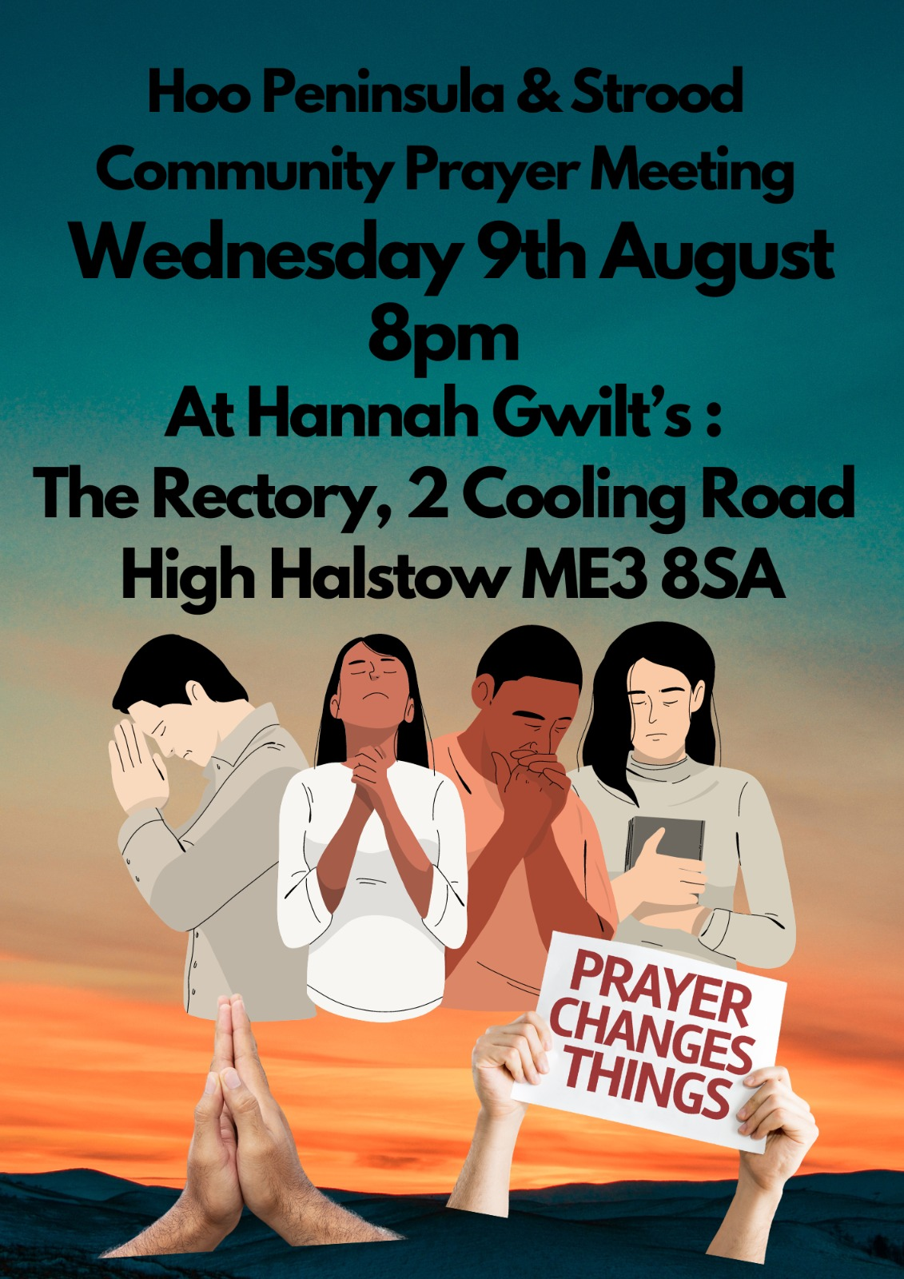

Slide 29


Slide 30


Slide 31
I Speak Jesus
CCLI Song # 7136201
Abby Benton | Carlene Prince | Dustin Smith | Jesse Reeves | Kristen Dutton | Raina Pratt
© 2019 Here Be Lions Publishing (Admin. by Integrity Music Ltd)
Integrity's Praise! Music (Admin. by Integrity Music Ltd)
BEC Worship (Admin. by Song Solutions)
Raina Pratt publishing designee (Admin. by Song Solutions www.songsolutions.org)
WriterWrong Music (Admin. by Song Solutions www.songsolutions.org)
Remaining portion is unaffiliated
For use solely with the SongSelect® Terms of Use. All rights reserved. www.ccli.com
CCLI Licence No. 33265

Slide 32
1/5
I just want to speak the Name of Jesus
Over ev'ry heart and ev'ry mind
'Cause I know there is peace within Your presence
I speak Jesus

Slide 33
2/5
I just want to speak the Name of Jesus
'Til ev'ry dark addiction starts to break
Declaring there is hope and there is freedom
I speak Jesus

Slide 34
3/5
('Cause) Your Name is power
Your Name is healing
Your Name is life
Break ev'ry stronghold
Shine through the shadows
Burn like a fire

Slide 35
4/5
I just want to speak the Name of Jesus
Over fear and all anxiety
To ev'ry soul held captive by depression
I speak Jesus

Slide 36
5/5
Shout Jesus from the mountains
Jesus in the streets
Jesus in the darkness over ev'ry enemy
Jesus for my fam'ly
I speak the holy Name Jesus

Slide 38
Amen!

